Slide 1
Case Study 1 - EDA
Prepared By:
Andrew Yule
John Worrall
Andrew Walch

Slide 2
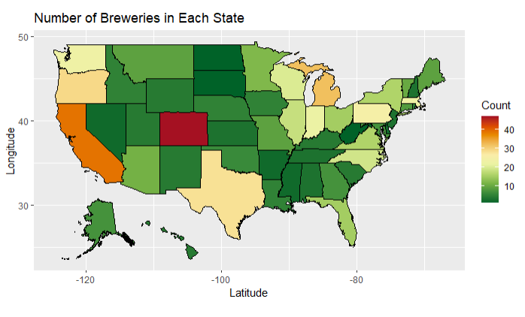
American Brewery Distribution
Top Ten States
(Most Breweries)
State Count
CO 47
CA 39
MI 32
OR 29
TX 28
PA 25
MA 23
WA 23
IN 22
WI 20
Colorado had the most breweries in America. The runners-up were California and Michigan.
Notes:
Colorado had the most breweries in America. The runners-up were Colorado and Michigan.
Many of the states with the most breweries are border states or states that receive major imports.

Slide 3
American Brewery Distribution
Bottom Ten States
(Least Breweries)
State Count
DC 1
ND 1
SD 1
WV 1
AR 2
DE 2
MS 2
NV 2
AL 3
KS 3
Washington DC, North Dakota, South Dakota, and West Virginia tied in having the least breweries in America.
Notes:
Washington DC, North Dakota, South Dakota, and West Virginia tied in having the least breweries in America.
Most of the states with the least number of breweries are mid-American. Therefore, having most breweries in a centrally located state like Colorado could be logistically advantageous.

Slide 4
Key Missing Values
International bitterness unit (IBV) is unreported for 42% of the data
Percentage of Data Missing for Given Category
Beer | Beer_ID | ABV | IBU | Brewery_ID | Style | Ounces | Brewery | City | State
0% | 0% | 2.6% | 42% | 0% | 0.2% | 0% | 0% | 0% | 0%

Slide 5
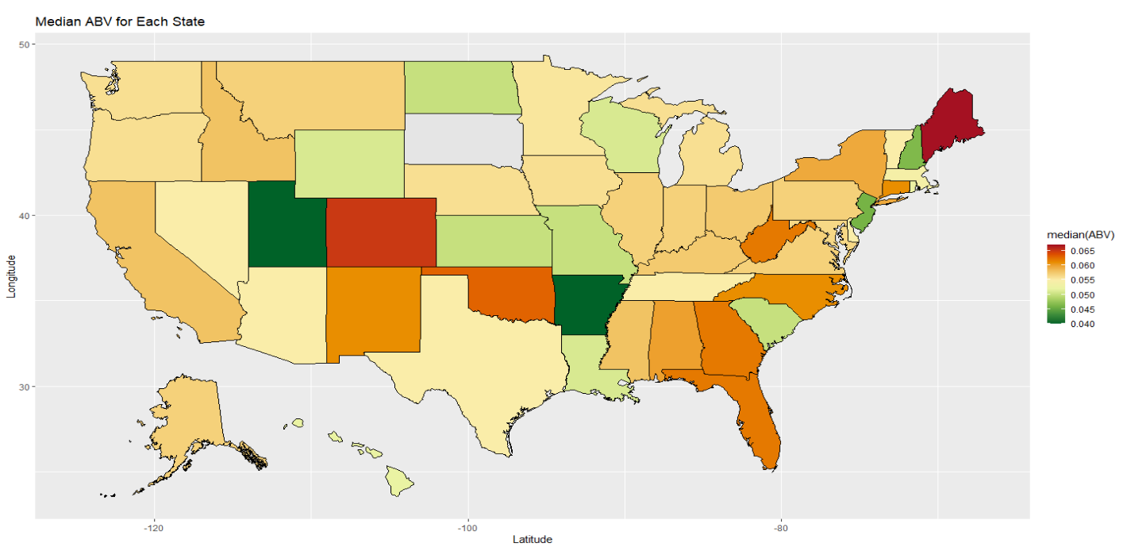
Median ABV for Each State
Maine had the highest median ABV in the USA ~ 0.067
Brewery with the max ABV was in KY ~ 0.125
Notes:
We wanted look at the map from a different perspective. Namely, see which states/regions had the highest median ABV (Alcohol By Volume). Maine had the highest MEDIAN at 6.7%. Whereas, Kentucky had the highest Maximum 12.5%

Slide 6
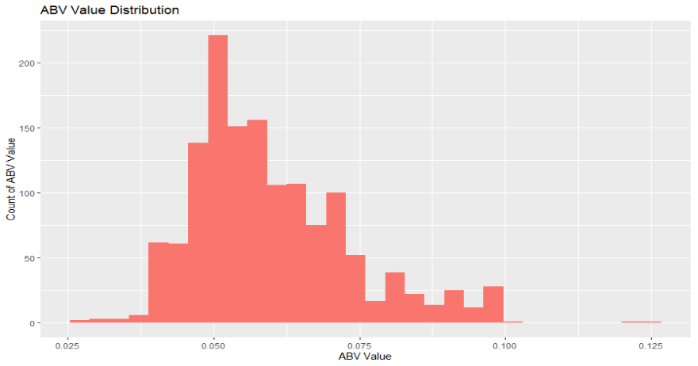
Nationwide ABV Distribution
ABV Value Summary Statistics
Min = 0.001 1st Quartile = 0.050
Mean = 0.06 Median = 0.056
Max = 0.128 3rd Quartile = 0.068
Notes:
The ABV values does not closely follow a normal distribution. In fact, it is slightly skewed right with a mean of 6% and median of 5.7%. This implies that there are other variables that are influencing the ABV values for beers across the country. This information begs to be further analyzed to find other factors that influence ABV values.

Slide 7
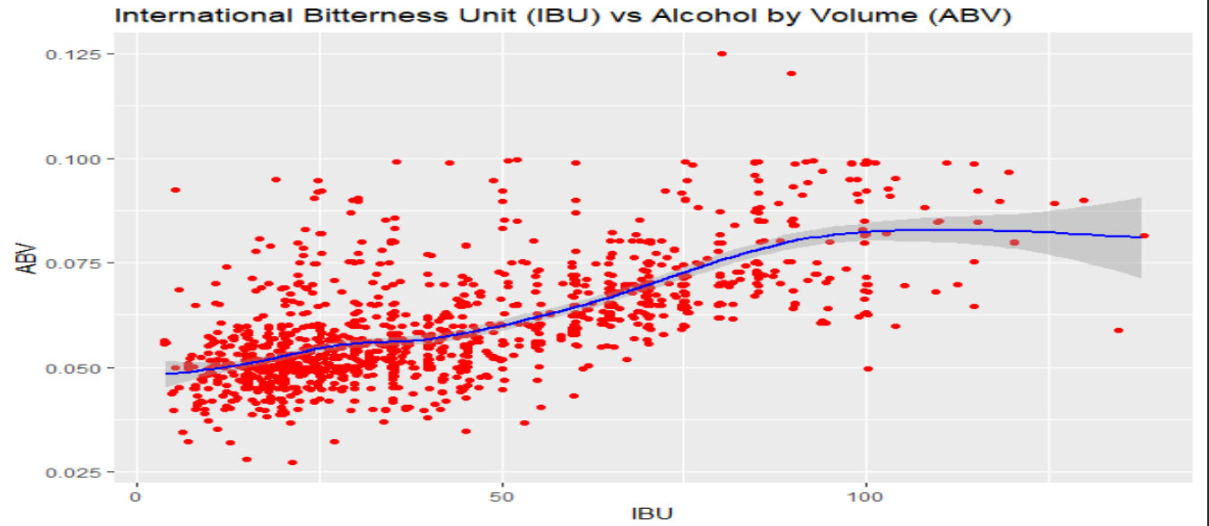
IBU vs ABV
Spearman Test for Correlation:
Alpha = 0.05
P-value = 2.2e-16
Correlation Coefficient = 0.6707224
Notes:
Conducted a statistical test to determine if there is a relationship between IBU and ABV. Based on the results of this test, we can conclude that IBU and ABV are significantly correlated.

Slide 8
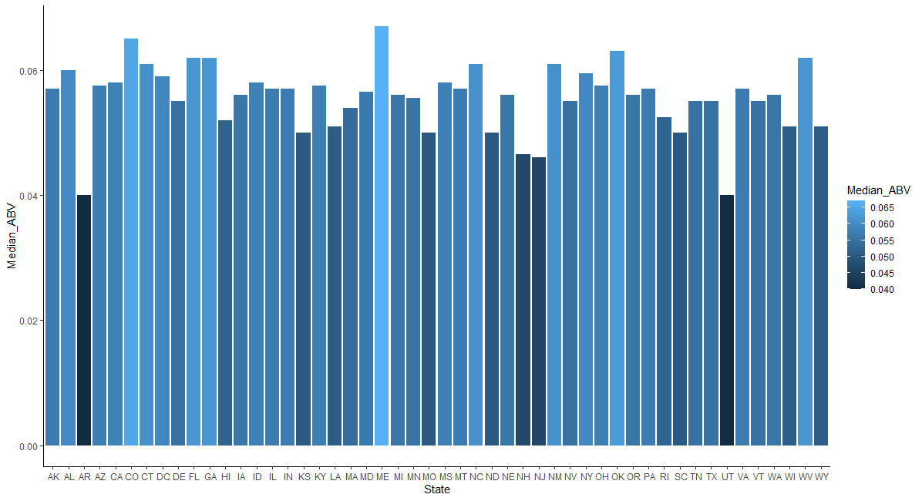
Median ABV Bar Chart

Slide 9
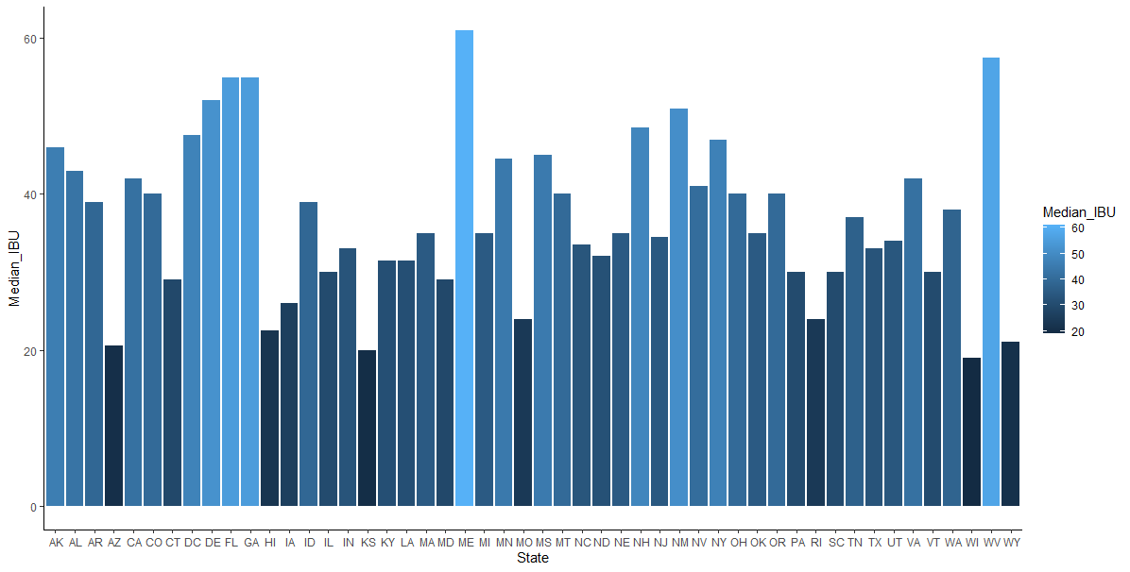
Median IBU Bar Chart

Slide 10
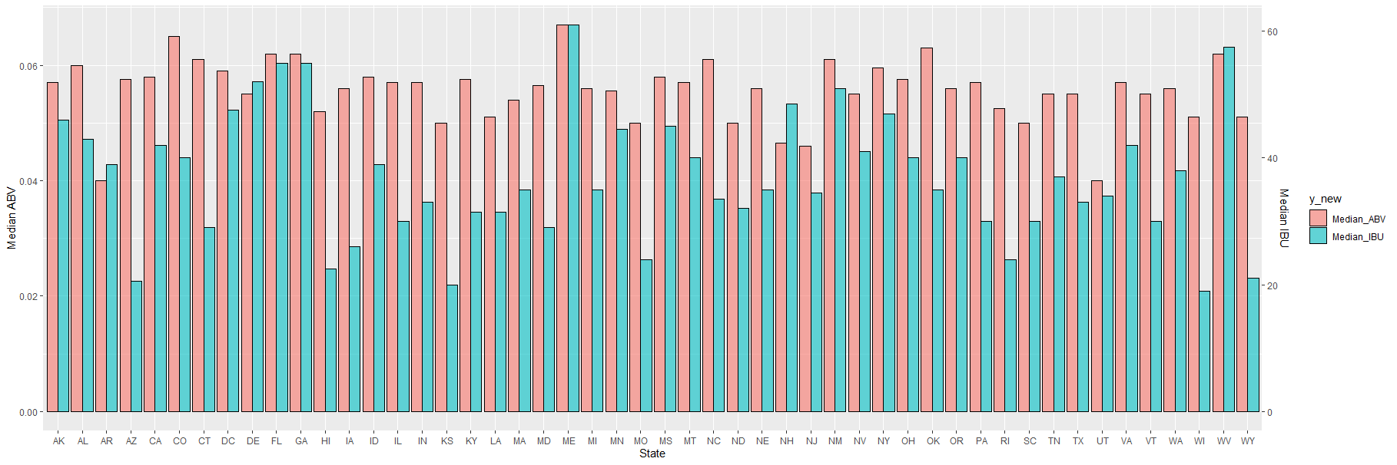
Median ABV and IBU for Each State

Slide 11
Median ABV for Each State
Maine had the highest ABV median in the USA ~ 0.067
West Virginia, Georgia, and Florida high median ABV values.
Notes:
So, lets take one more look at the median ABV map and see if there are these correlations exist state to state.

Slide 12
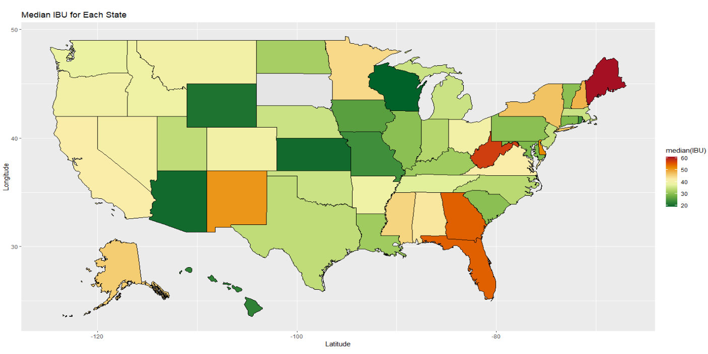
Median IBU for Each State
Maine had the highest IBU median in the USA ~ 61
West Virginia, Georgia, and Florida high median IBU values.
Notes:
As you can see some of the heavy hitters on the ABV map followed over to the IBU map.
This shows the correlation that we previously discussed.

Slide 13
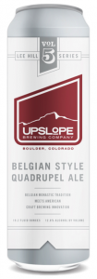
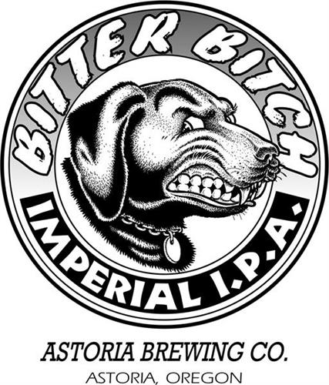
Maximum ABV and IBU
Max Overall ABV
Lee Hill Series Vol. 5 - Belgian Style Quadrupel Ale
Upslope Brewing Company
Colorado
ABV = 0.128
Max Overall IBU
Bitter B*tch Imperial IPA
Astoria Brewing Company
Oregon
IBU = 138

